Slide 1
Using Twitter to Powerfully Grow your PLN
Racquel Carlow @staopres

Slide 2
My creds:
Recently retired Physics teacher (after 36 years in the classroom)
STAO Past-president (2012-2013)
Chair of STAO Promotions/Social Media Committee
Started using Twitter in 2012 for professional learning
Spearheaded STAO’s entry into the social media arena

Slide 3
Focus phrases:
Using Twitter
Powerfully grow
Professional learning

Slide 4
Teacher Testimonial 1
“I follow interesting people on Twitter and this allows me to try their ideas.”
Brennan Caverhill @bpcaverhill
St. Cecilia CES
TCDSB

Slide 5
Teacher Testimonial 2
“I've connected with educators from all over the globe …
It has led to many professional opportunities such as conference speaking, Ministry of Ed writing teams, STAO project coaching, working with OTF on their professional development strategies… I've become a better educator”.
Colin Jagoe @colinjagoe
East Northumberland SS
KPRDSB

Slide 6
Teacher Testimonial 3
“… PD that is personalized to my needs. If there's something in particular I want to learn more about, I can usually find people who have tried it/designed it/are working with it currently and I can pick their brain.
It's also personalized to my timing - I'm getting the information I want WHEN I need it.
(Con’t)

Slide 7
Teacher Testimonial 3 (Con’t)
…allows me to connect SO EASILY with other teachers across Ontario, and around the world! It is an endless source of ideas and inspiration. So many teachers are doing amazing things, and it's great when I can connect with them (or connect my classes with them), or learn from their experiences.”
Heather Theijsmeijer @HTheijsmeijer
Manitoulin SS
RDSB

Slide 8
Teacher Testimonial 4
“… provides an instant source for ideas and advice. If I am ever struggling with something or need help, I tweet. In an instant, I will have help from my PLN. You are also connected to the amazing world around you. Teaching can be so lonely. We are often inside our own walls and most of the time we don't even know what our colleague next door is working on. Twitter allows you to feel part of a community, connected to others and learning from all the amazing awesomeness.”
Jonathan So @MrSoclassroom
Ray Lawson PS PDSB

Slide 9
Twitter for professional learning: what do we gain?
Ideas
Inspiration
Encouragement
Connectedness

Slide 10
Twitter for professional learning: what’s lacking?
Sustained focus
Depth
Application
Impact on student learning

Slide 11
Powerful professional learning …
Intensive
Ongoing
Connected to practice

Slide 12
“To tweet or not to tweet … ?”
What do we gain? | What is lacking?
Ideas | Sustained focus
Inspiration | Depth
Encouragement | Application
Connectedness | Impact on student learning
* Distilled from a blog by @TonyaWardSinger

Slide 13
How to get started with Twitter?
Create an account
“Follow” others
Create “lists”
“Like” specific content
Start “tweeting”

Slide 14
Need help? STAO’s Professional Learning Network www.stao.org

Slide 15
STAO/APSO is here to help …

Slide 16
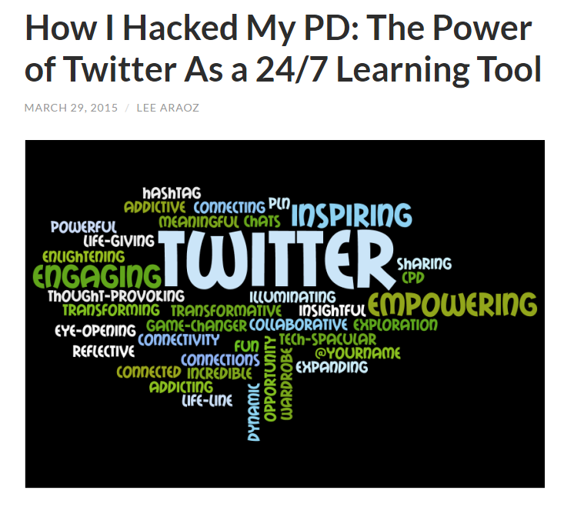
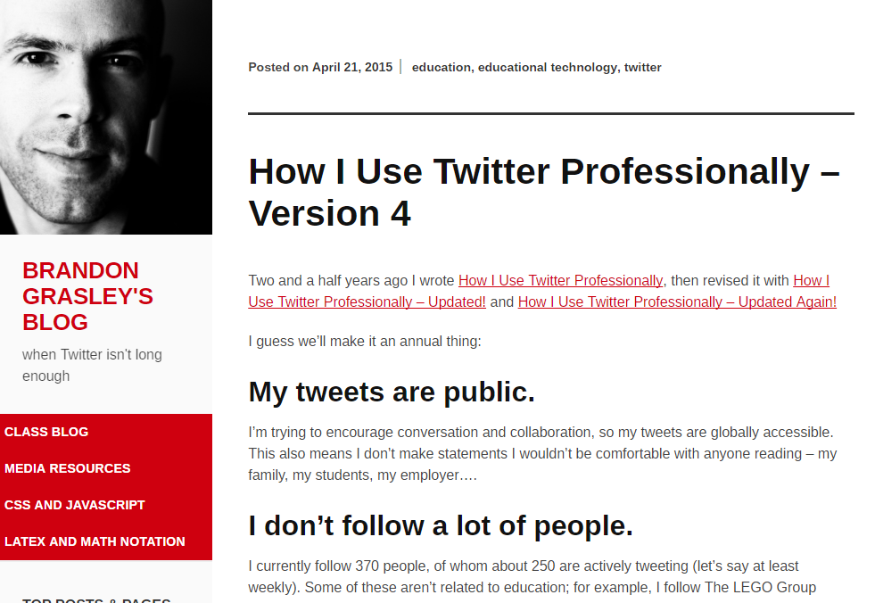
Still need more help?

Slide 17
“Tweet globally; act locally.”
Student learning
impact
Teaching practice
transform
Professional learning
enhance
Twitter

Slide 18
Start to grow your PLN by following:
@staoapso
@bpcaverhill
@colinjagoe
@HTheijsmeijer
@MrSoclassroom
@staopres

